Slide 1
INFORM 2014/ ‘A Tale of Two Cities’: the perks and perils of online feedback tools
Carla Morris & Seb Cadinot
pathwaymanagers@kent.ac.uk

Slide 2
GradeMark use on the Kent IFP
GradeMark: the basics (and not so basics)
Enhanced feedback & student experience
The perks and perils of online feedback
Discussion
Conclusion + Q&A

Slide 3
GradeMark use on the Kent IFP
2006
TurnItIn on all modules
2010
GradeMark on some modules
2012
Paperless submissions only
GradeMark on all modules
Paperless submissions only
2013
Tutor choice re marking

Slide 4
GradeMark Use – IFP Student Evaluation
Module Evaluation Questionnaires:
Having online feedback on my Moodle-based assignments was preferable to written or printed feedback
Average of 4.2 out of 5 over 15 modules
Modules where academics give ample feedback scored over-average marks
Modules where academics give sparse feedback scored below 4.0

Slide 5
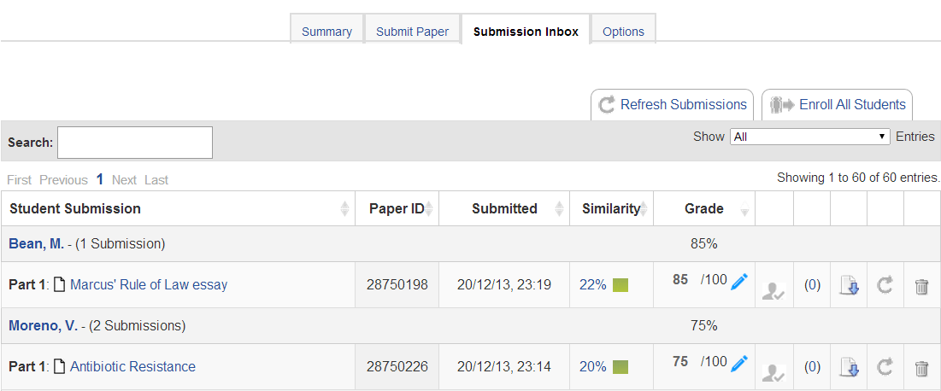
GradeMark – the basics

Slide 6
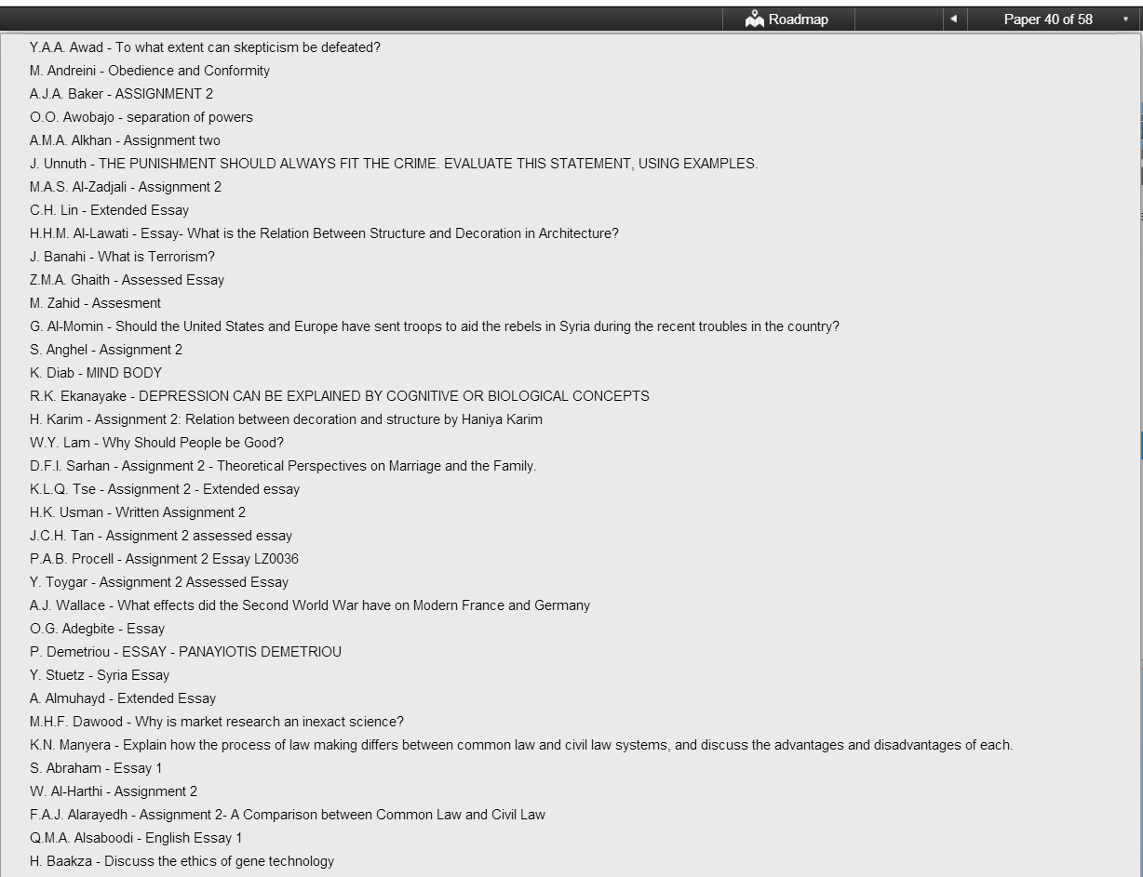
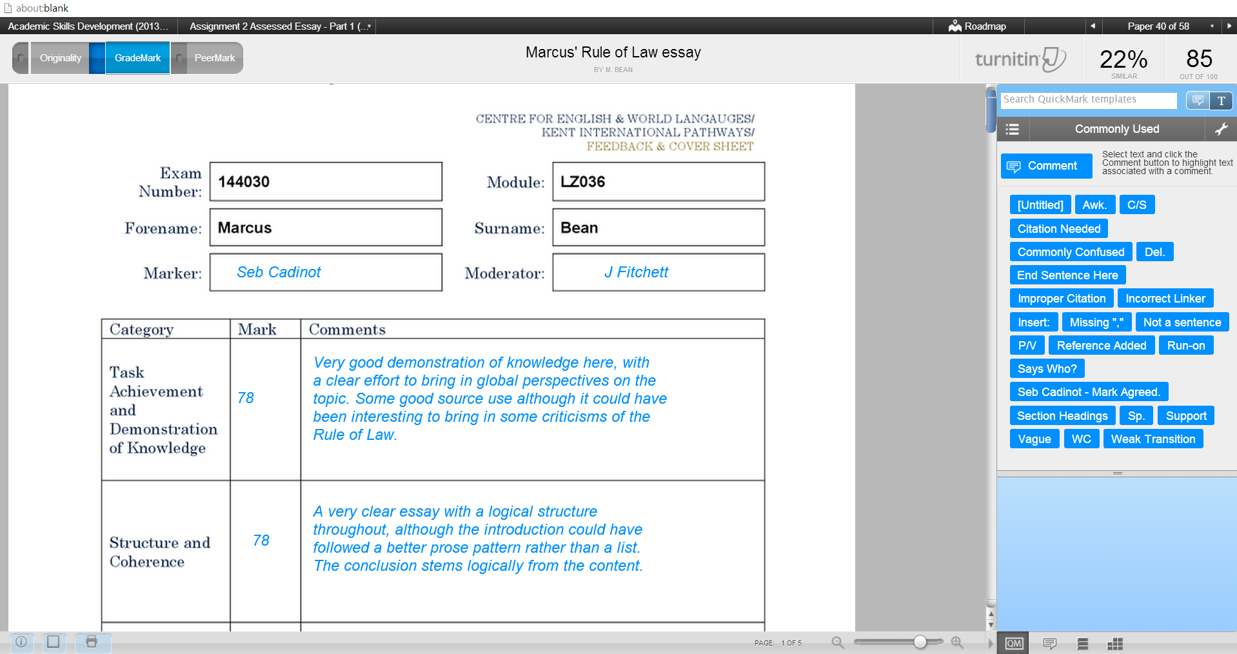
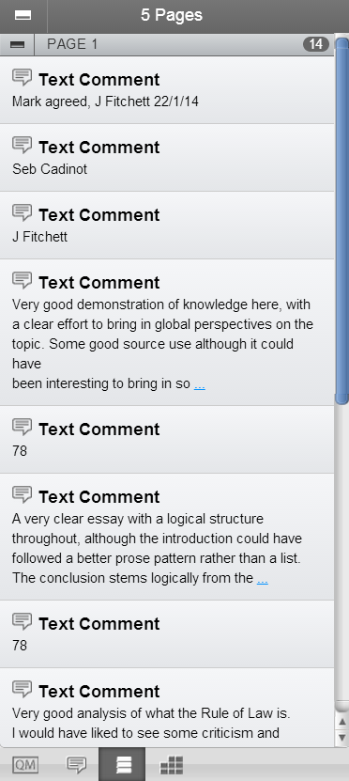
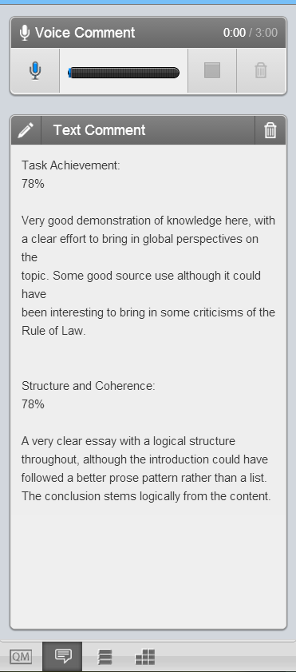
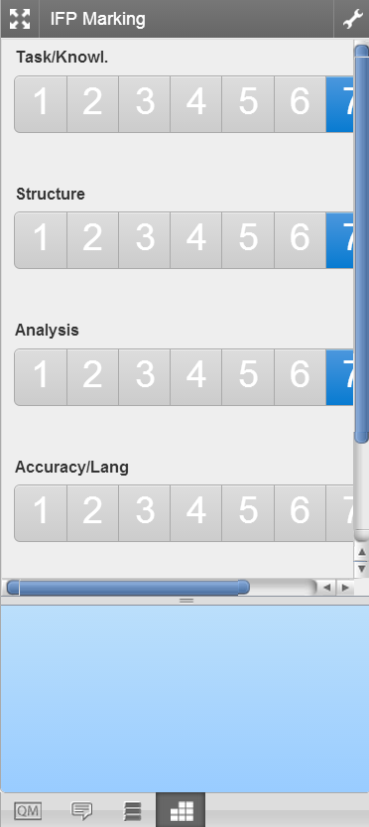
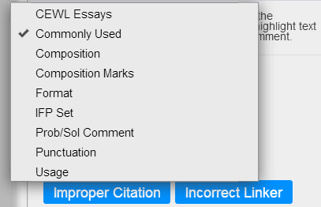
GradeMark – the basics

Slide 7
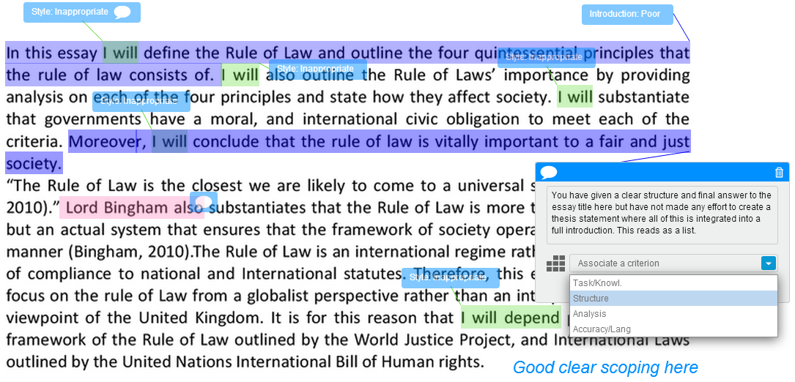
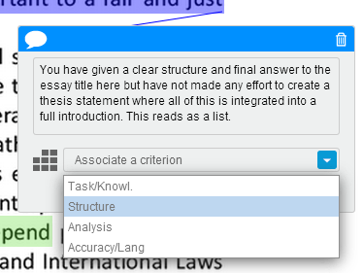
GradeMark Use – Quick Marks

Slide 8
GradeMark Use – Qualitative Rubric

Slide 9
GradeMark Use – Scoring Rubric
Multiple parts to a single assignment
Final grade is automatically calculated

Slide 10
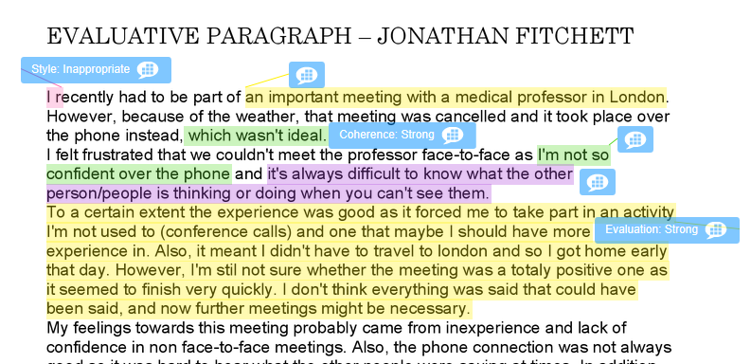
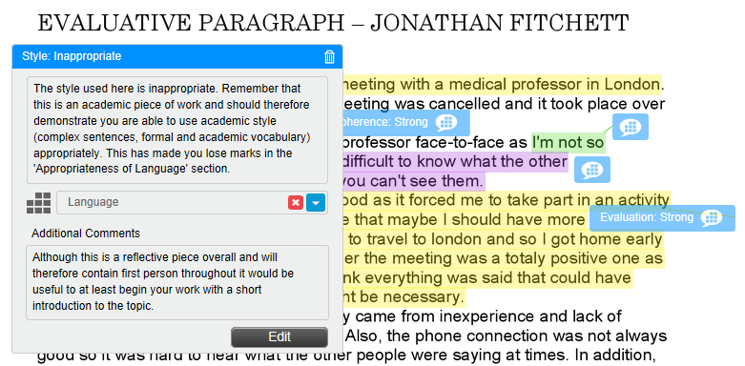
GradeMark Use – Scoring Rubric

Slide 11
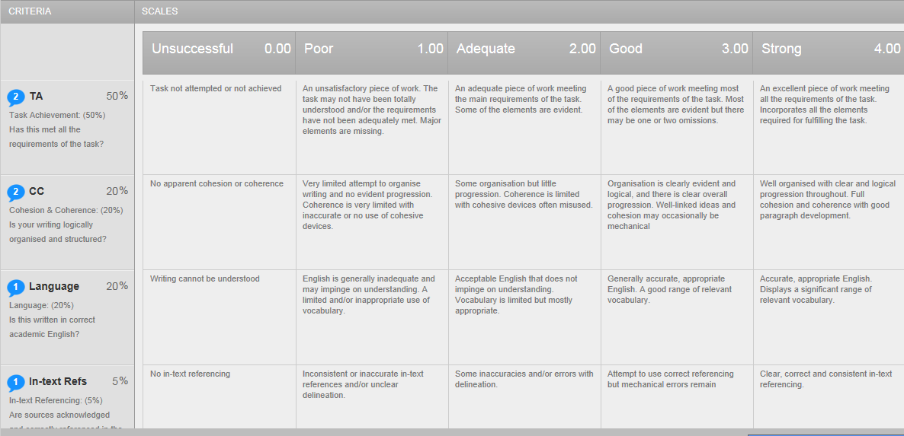
GradeMark Use – Scoring Rubric

Slide 12
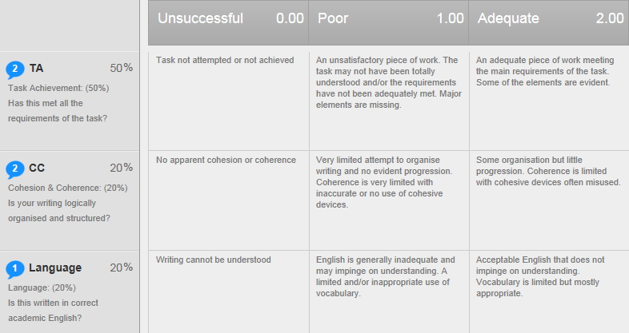
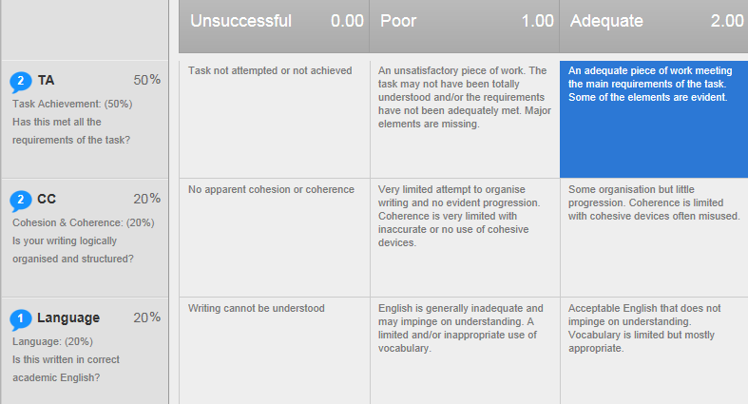
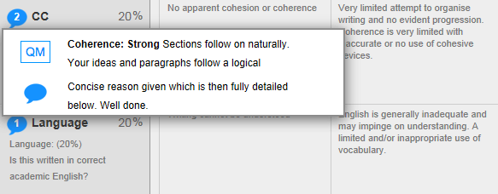
GradeMark Use – Scoring Rubric

Slide 13
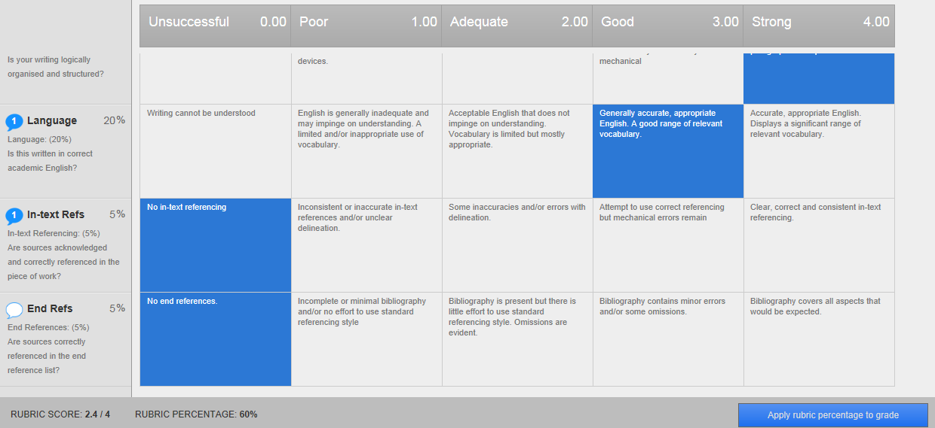
GradeMark Use – Scoring Rubric

Slide 14
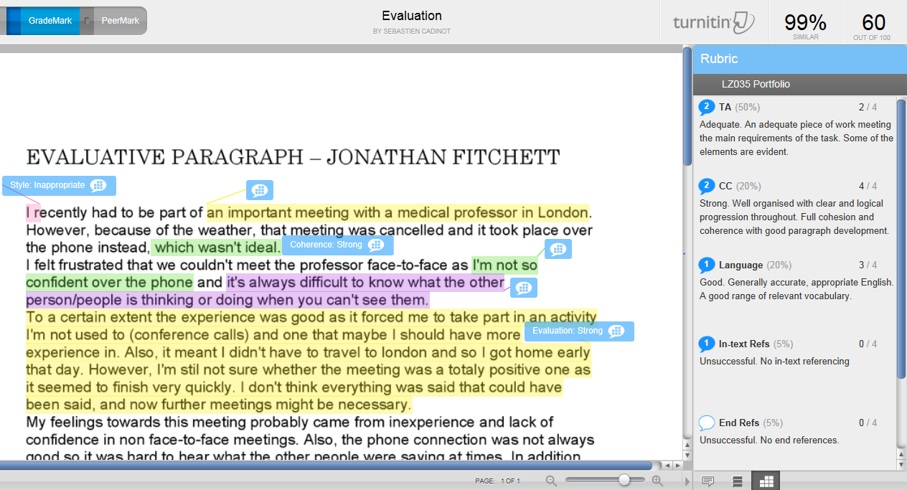
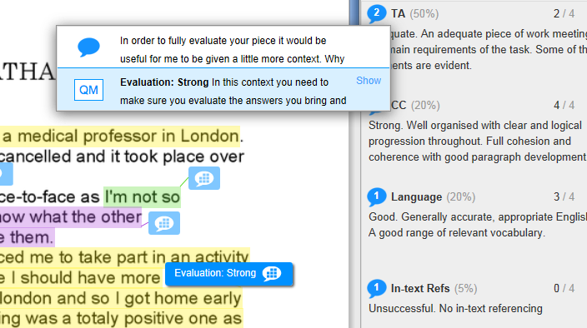
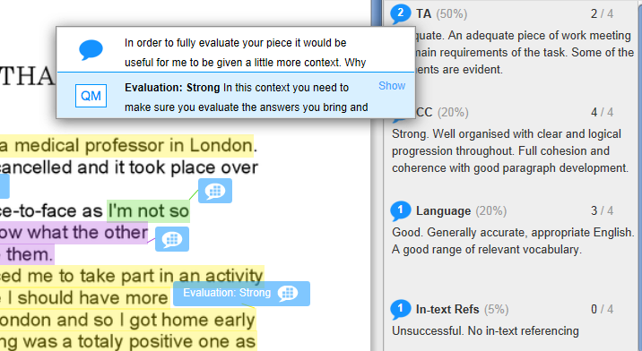
GradeMark Use – Scoring Rubric

Slide 15
GradeMark – Enhanced Feedback
Opportunity for rich and useful feedback
Free-text / QuickMarks / Rubrics / Oral feedback / General comments
Rapidity of marking
Scoring rubric with comments / Mark anywhere (with internet or iPad) / QuickMarks / Typed vs Written
Standardisation across markers and modules
Defined Rubric & QuickMarks / Visible to all markers
Allows for preparation prior to marking
Rubric & QuickMarks created for specific assignment
Accessibility
Moderation / External Examining / Academic Adviser feedback /
Cannot be lost!

Slide 16
The Perks & Perils of Online Feedback
Growing body of research in this area:
Electronic Grading And Marking: A Note On Turnitin’s Grademark Function
(Henderson, P. 2008)
Online Originality Checking and Online Assessment - an Extension of Academics or Disruption for Academics
(Chew, E. & Price, T. 2010)

Slide 17
The Perks & Perils of Online Feedback
Evaluation of GradeMark for electronic assessment & feedback: Staff and students’ perspectives.
(Sawdon, M. & Curtis, F. 2012)
‘Healthcare Students’ Perceptions of Electronic Feedback through GradeMark®’
(Watkins, D. et al 2014)

Slide 18
The Perks & Perils of Online Feedback

Slide 19
The Perks & Perils of Online Feedback
Pros:
easy to access
can check originality
saves paper
Cons:
clunky and difficult/fiddly to use
Internet connections – slow; loss of comments
Glitches & bugs

Slide 20
The Perks & Perils of Online Feedback
Students do not look at the feedback anyway

Slide 21
The Perks & Perils of Online Feedback

Slide 22
The Perks & Perils of Online Feedback
‘We wanted to build on the Maguire presentation from the previous year, which was largely positive, and did not match up with our more negative experiences of the software.’
(Courtenay & Coleman 2013)

Slide 23
The Perks & Perils of Online Feedback
Some of the suggested strategies…
Prioritise positives and ways to improve over negative/positive feedback
Build reflection on feedback into the assessment
One-to-one feedback/tutorial sessions
(Courtenay & Coleman 2013)

Slide 24
The Perks & Perils of Online Feedback
‘Grademark enhanced the teaching and assessment experiences from a pedagogical-oriented aspect. In contrast the main disruption came from the technology’
(Chew & Price 2010 p 686)

Slide 25
The Perks & Perils of Online Feedback
‘ Pedagogy should shape computers and its [sic] uses’
(Chew & Price 2010 p 683)

Slide 26
The Perks & Perils of Online Feedback
Promotes one-size fits all approach
Assumes teachers all mark in the same way
Encourages ‘competitive’ or over-marking marking
Editable
Turn It In – used as a plagiarism ‘smoke-screen’

Slide 27
The Perks & Perils of Online Feedback
Comparison between reading on a screen versus reading on paper
‘Screens are more physically and mentally taxing’
‘Scrolling drains more mental resources’
(Wästlund 2007)

Slide 28
The Perks & Perils of Online Feedback
A 2008 survey of people born between 1980 – 2000 indicated that people preferred reading on paper rather than computer screens.
(Ferris 2013)
In order to ‘understand with clarity’, text on paper is preferable to reading on a screen (survey findings, 2011)
(Ferris 2013)

Slide 29
The Perks & Perils of Online Feedback
Research at the University of Stavanger
Text navigation [on a computer screen] subtly inhibits reading comprehension
(Mangan, Walgermo & Bronnick 2013)

Slide 30
The Perks & Perils of Online Feedback
Noyes and Garland (2008)
Notwithstanding speed and convenience
Assessing on computer is more tiring
Concentration is affected
Cognitive workload and memory are affected
Easier to look through items and to move back and forth on paper
Equivalence is growing

Slide 31
Discussion
In your experience, does Grademark support or distract from the marking process?
From your students’ perspective, does Grademark offer enhanced feedback opportunities?
Are we seeking to use this technology for the sake of using technology?

Slide 32
Conclusion
There are clear advantages to using online marking (Grademark)
Pros
Convenient (accessible)
Quick
It avails the marker of a wider range of feedback tools & facilitates one to one discussion
Standardisation across markers

Slide 33
Conclusion
Cons
Technology is clunky
Can discourage feedback
Relies on a sound internet connection
Reading on a screen is generally less preferable (and arguably) less effective than reading on a page

Slide 34
Bibliography
Chew, E. & Price, T. Online Originality Checking and Online Assessment - an Extension of Academics or Disruption for Academics. Proceedings of the 18th International Conference on Computers in Education S. L. Wong et al. (Eds.) (2010) . Putrajaya, Malaysia: Asia-Pacific Society for Computers in Education.
Courtenay, C. and Coleman, R.C. (2013) Using Grademark – Getting students interested in online feedback. Canterbury: University of Kent
Ferris, J. (2013) The Reading Brain in the Digital Age: why paper still beats screen. Scientific American. 309 (5)
Mangan, A. Walgermo, B.R., Bronnick, K. (2013) Reading Linear Texts on Paper versus Computer Screen. Effects on Reading Comprehension. International Journal of Educational research. 58 pp 61 - 68

Slide 35
Bibliography
Noyes, J.M. & Garland, K. J. (2008) Computer versus Paper-based Tasks: are they equivalent? Ergonomics 51 (9) pp 1352 – 1375
Wästlund, E. (2007) Experimental Studies of Human-Computer Interaction: working memory and mental workload in complex cognition [Online]. Available from: https://gupea.ub.gu.se/bitstream/2077/4693/1/gupea_2077_4693_1.pdf [Accessed 17 July 2014]
Watkins, D., Dummer, P., Hawthorne, K., Cousins, J., Emmett, C., & Johnson, M.. (2014). Healthcare students’ perceptions of electronic feedback through GradeMark®. Journal of Information Technology Education: Re-search, 13, 27-47. Retrieved from: http://www.jite.org/documents/Vol13/JITEv13ResearchP027-047Watkins0592.pdf

Slide 36
INFORM 2014/ ‘A Tale of Two Cities’: the perks and perils of online feedback tools
Carla Morris & Seb Cadinot
pathwaymanagers@kent.ac.uk

